Slide 1

Car Insurance Claim Prediction and Risk Analysis
Sai Karthik
Notes:
Welcome to this presentation on Car Insurance Claim Prediction and Risk Analysis. In this project, we aim to explore how data analysis can provide insights into car insurance claims, focusing on predicting claims and evaluating associated risks

Slide 2

AGENDA
INTRODUCTION AND PROBLEM STATEMENT
DATA COLLECTION AND PREPROCESSING
DATA SETS AND VISUALIZATIONS
SUMMARY AND CONCLUSION
Notes:
Today's presentation will begin with an introduction and a problem statement, where we’ll discuss the challenges faced in the car insurance claims sector and the objectives of this project. We will then move into data collection and preprocessing, covering how we gathered and prepared the data for analysis. Following that, we will explore the data sets and visualizations used to derive insights, focusing on the relationships and trends found through visual analysis. Finally, we will wrap up with a summary and conclusion, highlighting key findings and potential implications of the project.

Slide 3

INTRODUCTION
Changing Landscape
The automotive and insurance sectors are evolving quickly, presenting both challenges and opportunities for stakeholders such as policyholders, insurers, policymakers, and researchers.
Data Complexity
Car insurance data is large and varied, often represented in raw numerical forms.
This complexity makes it hard for stakeholders to extract useful insights or make informed decisions.
Project Objective
The aim is to provide actionable insights from car insurance data.
The focus is on analyzing key factors like driver demographics, vehicle details, behavioral patterns, and claim history to help optimize decision-making.
Notes:
The car insurance industry is evolving rapidly alongside advancements in automotive technologies and shifting insurance landscapes. This creates numerous challenges and opportunities for various stakeholders, including policyholders, insurers, policymakers, and researchers. The data involved in car insurance is vast and diverse, often presented in raw numerical forms, which makes extracting meaningful insights challenging for stakeholders. The goal of this project is to address these challenges by providing data-driven insights into car insurance claims, focusing on key aspects like driver demographics, vehicle details, behavioral patterns, and claim history. By analyzing these factors, the project aims to make the data more accessible and support informed decision-making.

Slide 4

Problem STATEMENT
Challenges in Car Insurance Claims
Car insurance claims have far-reaching consequences for policyholders, insurers, and the industry as a whole.
Rising claims are driven by multiple factors, including increased vehicle ownership, changing driving patterns, and fraudulent activities.
Traditional methods struggle to:
Identify policyholders most likely to file claims.
Provide accurate premium pricing.
Detect fraudulent claims efficiently.
Notes:
Car insurance claims present significant challenges for all stakeholders, including policyholders, insurers, and the industry as a whole, due to their far-reaching consequences. The frequency of claims is increasing, driven by factors such as growing vehicle ownership, changes in driving patterns, and fraudulent activities. Traditional methods face difficulties in keeping up with these changes, struggling to effectively identify policyholders most likely to file claims, provide accurate premium pricing, and detect fraudulent claims efficiently. These challenges underscore the need for more advanced, data-driven approaches to improve the accuracy and efficiency of the claims process. Key Questions for Analysis: What are the critical risk factors for claims? How can insurers balance affordability with risk management? What demographic or behavioral patterns indicate higher likelihoods of claims?

Slide 5

OBJECTIVES
Key Goals:
To provide in-depth insights into car insurance claims through data visualization techniques.
To identify trend patterns and critical factors influencing claim likelihood, fraudulent claims, and premium pricing.
Our objectives for findings to represent in visualizations:
How have claim patterns evolved over the past year, and what factors are driving these changes?
What percentage of policyholders belong to high-risk categories?
What is the demographic breakdown of claimants, and how does it correlate with risk factors?
Are there any emerging trends or behaviors that could significantly impact claim rates?
How do geographic and behavioral factors affect the likelihood of claims?
Notes:
The main goal of our project is to provide comprehensive insights into car insurance claims by employing data visualization techniques and to identify trend patterns and influential factors that impact claims, fraud, and premium pricing. Specifically, we tried to explore how claim patterns have changed over the past year and determined the factors driving these changes. Another key objective we tend to determine is the percentage of policyholders who fall into high-risk categories. Additionally, we analyzed the demographic breakdown of claimants and assessed how these demographics correlate with risk factors. We also identified any emerging trends that could significantly impact claim rates. Finally, we investigated how geographic and behavioral factors influence the likelihood of claims, which can help improve decision-making for all stakeholders involved. these objectives will not only provide stakeholders with a deeper understanding of the risks involved but also help in making informed decisions for pricing and claims management.

Slide 6
TASKS OUTLINE
COMPREHENSIVE DATA COLLECTION AND CLEANING
Analysis of type of Visualization
PYTHON INTEGRATION
Notes:
Our project workflow starts with comprehensive data collection and cleaning. This is a crucial step to ensure that we have accurate, relevant, and consistent data to work with, as clean data forms the backbone of reliable analysis. Once the data is prepared, we moved to the analysis of types of visualization. It involved determining the most suitable visual representations that can effectively convey the patterns and insights hidden within the data. The right type of visualization is key to making complex information accessible and easy to understand for stakeholders.

Slide 7
DATA COLLECTION AND PREPROCESSING
Data Sources
The dataset was collected from Kaggle and verified for accuracy and reliability.
Preprocessing Steps
The dataset underwent a comprehensive preprocessing phase to enhance its quality and usability.
Missing data points were identified and addressed using imputation techniques to maintain data integrity.
Dataset Information
Contains diverse details, including driver demographics, vehicle information, claims history, and behavioral patterns (e.g., violations, accidents).
Notes:
For this project, the dataset was sourced from Kaggle, a reputable platform for data sharing, ensuring accuracy and reliability for our analysis. In the preprocessing phase, several steps were undertaken to enhance the dataset’s quality and usability. First, a comprehensive preprocessing phase was conducted to clean and standardize the data. Missing data points were identified and addressed to ensure data integrity and maintain consistency throughout the dataset. The dataset contains a variety of information, including driver demographics, vehicle details, claims history, and behavioral patterns, such as traffic violations and accidents.

Slide 8
DATA COLLECTION AND PREPROCESSING
Cleaning Process:
Rigorous cleaning ensured the dataset is free from inconsistencies or errors.
Categorical variables were encoded into numerical formats for analysis.
Data Storage:
The cleaned and processed data was saved in a new CSV file to serve as a reliable dataset for analysis and visualization.
Notes:
In the data collection and preprocessing stage, a thorough cleaning process was undertaken to ensure the dataset was free from inconsistencies or errors. This included rigorous cleaning, removing null values, to remove anomalies and make sure all data points were reliable for analysis. The cleaned and processed dataset was then saved in a new CSV file

Slide 9

Data SETS AND Visualizations

Slide 10

TASKS SOLVED
Key Steps in the Project
Data Collection and Preprocessing
Demographic and Behavioral Analysis
Trend Identification
Visualization and Insights
Notes:
Key Steps in the Project:
Data Collection and Preprocessing:
Collected and preprocessed a diverse dataset containing driver demographics, vehicle details, claims history, and behavioral patterns.
Cleaned the data to remove missing entries and inconsistencies, ensuring a reliable dataset.
Demographic and Behavioral Analysis:
Explored how demographic factors like age, gender, and income influence claim likelihood.
Analyzed behavioral patterns such as past violations, speeding incidents, and DUI records to determine their correlation with claims.
Trend Identification:
Investigated how claim patterns have evolved over time.
Identified emerging trends that could impact future claims and premium pricing.
Visualization and Insights:
Created visualizations to represent findings, such as correlation heatmaps, demographic distributions, and behavioral impact analysis.

Slide 11
DEFINING KEY FEATURES
Parameter 1:
Age
Gender
Driving Experience
Education
Parameter 2:
Income
Credit Score
Vehicle Ownership
Vehicle Year
Parameter 3:
Speeding Violations
Postalcode
Past Accidents
Annual Mileage
Notes:
we identified several key features that influence car insurance claims and risk analysis. These features include demographic factors such as age, gender, education, and income, which provide insights into the profile of policyholders. We also consider driving-related parameters, including driving experience, vehicle ownership, vehicle year, and annual mileage, which help assess the risk associated with different drivers. Additionally, financial factors like credit score play a role in evaluating the likelihood of claims. Finally, behavioral factors, including speeding violations, past accidents, and postcode, are crucial in understanding driving habits and risk exposure. These features collectively provide a comprehensive view of the factors that impact car insurance claim probabilities.

Slide 12
DATA SETS
The car insurance dataset we used was sourced from Kaggle. This dataset includes information about policyholders, their demographics, vehicles, driving behavior, and claim history. The data is organized into several features, enabling comprehensive analysis of the factors influencing claims.
Features in the dataset
Demographic Information
Vehicle Details
Behavioral Indicators
Dataset Source
Kaggle: Car_Insurance_Claim.csv
Notes:
Features in the dataset:
Demographic Information:
Age, Gender, Income, Education Level
Vehicle Details:
Ownership (owned/financed), Year of Manufacturing, Type of Vehicle
Behavioral Indicators:
Past speeding violations, Past accidents, Annual mileage

Slide 13
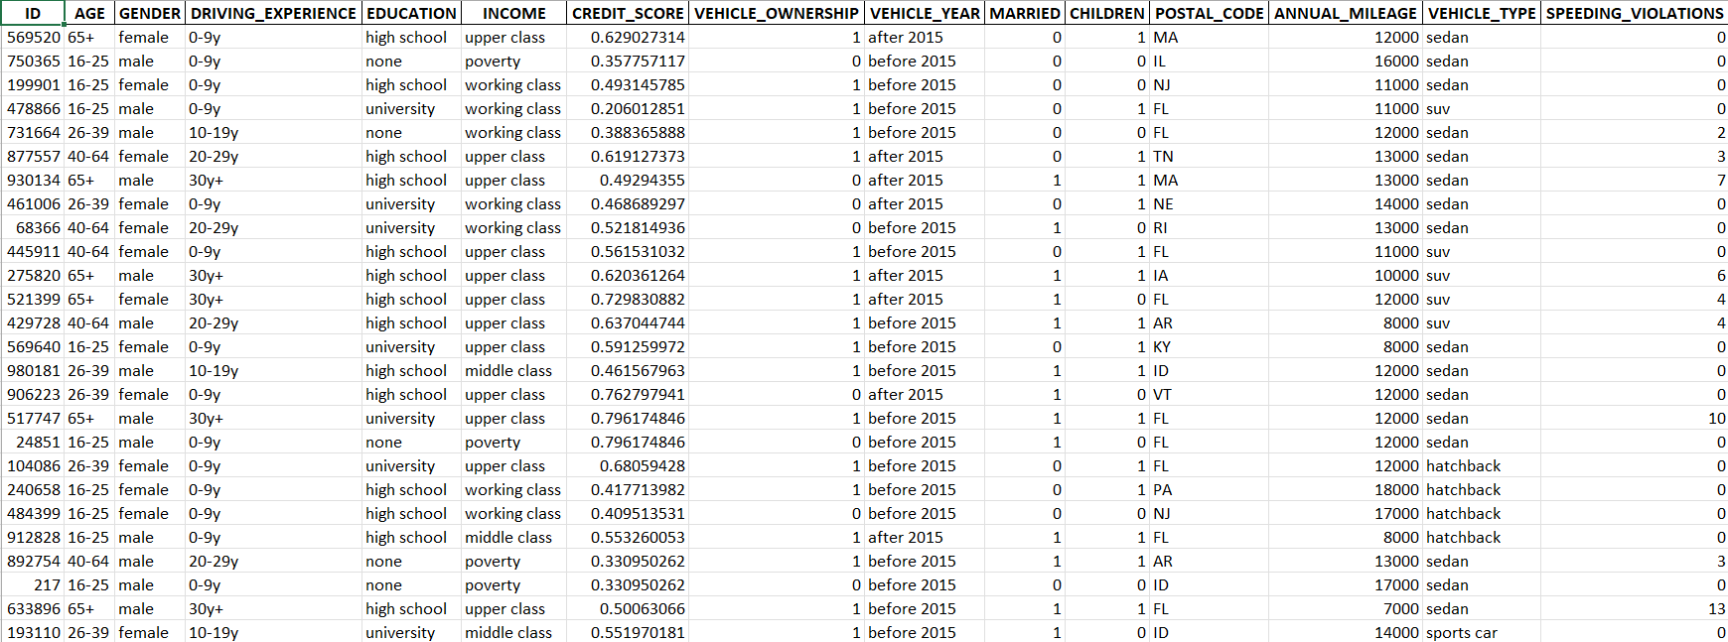
Data set

Slide 14
Data set

Slide 15
​
DATA VISUALIZATIONS AND THEORY COVERED
Visualization Focus
We will use features such as Age, Income, Credit Score, Vehicle Ownership, and behavioral metrics like Speeding Violations and Past Accidents for various visualizations.
Primarily utilizing bar charts, scatterplots, heatmaps, and histograms for insights. Visualization Techniques
Highlight correlations between demographics and claim likelihood.
Explore the impact of behavioral factors (e.g., speeding violations,) on claim outcomes. Principles Applied
Use correlation matrices to uncover relationships between features.
Implement bar and scatterplots for demographic and behavioral trends.
Notes:
In our analysis, we focused on creating data visualizations to derive insights from features such as age, income, credit score, vehicle ownership, and behavioral metrics like speeding violations and past accidents. We used several types of visualizations, including bar charts, scatterplots, heatmaps, and histograms, to help uncover relationships in the data. Our approach to visualization techniques includes highlighting correlations between demographic variables and claim likelihood, as well as exploring the impact of behavioral factors on claim outcomes. We also used correlation matrices to reveal relationships between features and implement bar and scatterplots to visualize demographic and behavioral trends effectively.

Slide 16
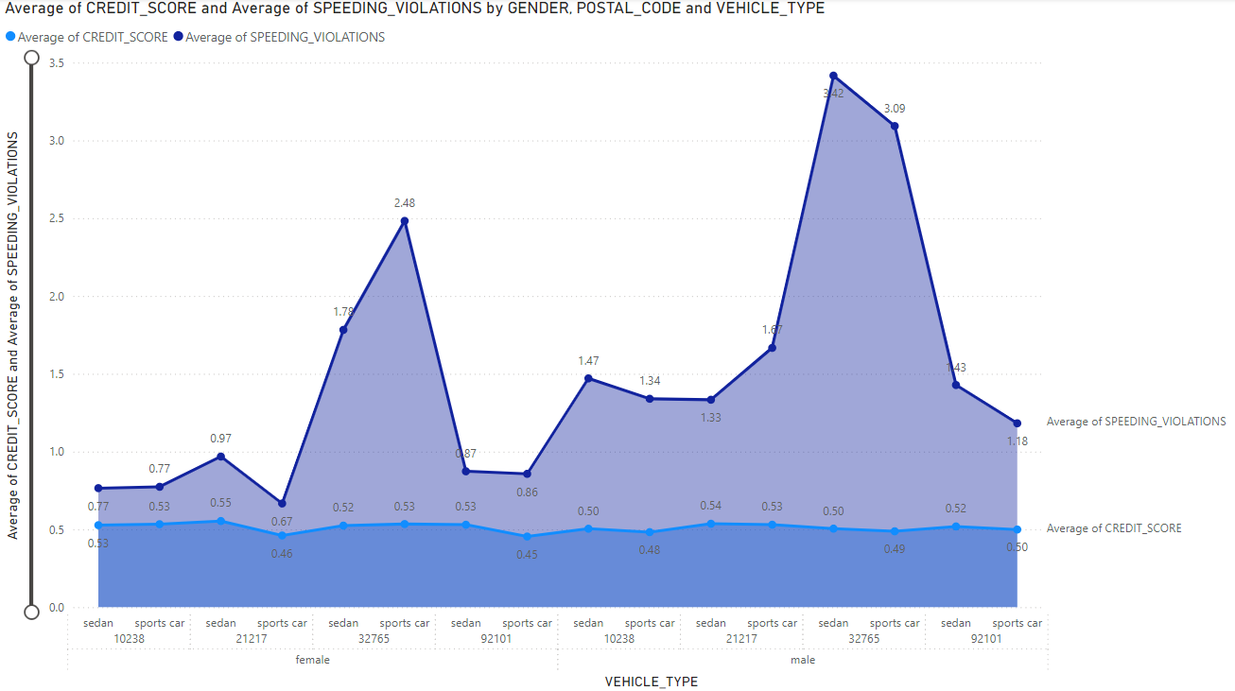
Comparison of Average Credit Score and Speeding Violations by Vehicle Type and Gender
Notes:
Overview:
This visualization compares the average Credit Score and average Speeding Violations across categories defined by Gender, Postal Code, and Vehicle Type.
The light blue line represents Credit Score, while the dark blue line represents Speeding Violations
Key Observations:
Gender Differences:
On average, male drivers have significantly higher speeding violations compared to female drivers.
Insights and Implications:
This data can be used to understand risk factors more clearly, such as how vehicle type and gender influence driving behavior.
This visualization presents a comparison of average credit scores and speeding violations based on vehicle type and gender. The chart illustrates how different vehicle types (sedans and sports cars) correlate with credit scores and speeding violations for male and female drivers. We can observe that drivers of sports cars generally have higher instances of speeding violations, with peaks reaching up to 3.09 on average. Additionally, the credit scores show less variation compared to speeding violations but do indicate some differences by vehicle type and gender. These insights highlight the behavioral differences among different groups, which can be useful for insurers in assessing risk more accurately.

Slide 17
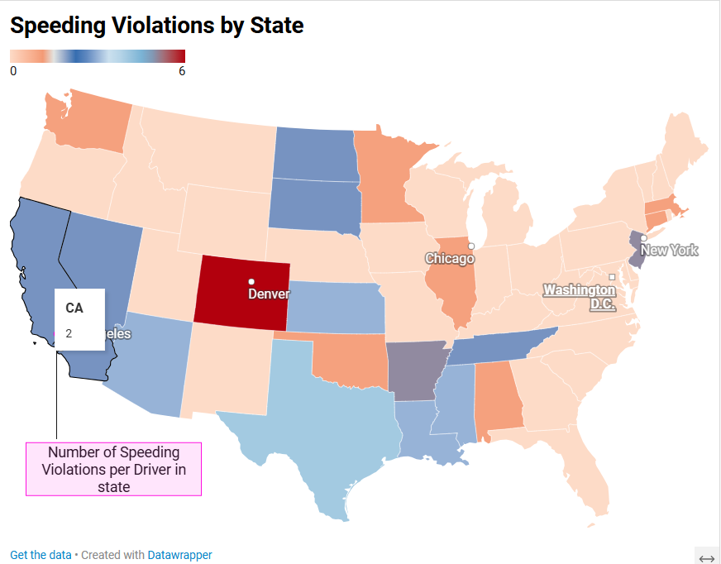
Geographic Distribution
Notes:
Overview:
This map illustrates the number of speeding violations per driver in each state across the United States.
States are color-coded from light to dark based on the average violations—darker shades represent higher violations.
Key Highlights:
Colorado (Denver) has the highest average speeding violations per driver, marked by the deep red color.
California (CA) shows a relatively moderate level, with an average of 2 violations per driver.
Insights and Applications:
This data can assist insurance companies and traffic authorities in identifying high-risk areas.
This map illustrates the geographic distribution of speeding violations across various states in the United States. Each state is color-coded to indicate the average number of speeding violations per driver, with darker colors representing higher violation rates. Notably, Colorado (highlighted around Denver) has a high concentration of speeding violations, indicated by the deep red shading. In contrast, states such as California and others in the western region show relatively lower rates of violations, marked by lighter shades of blue. This geographic insight can help insurers assess the risk level associated with drivers in different regions, enabling more precise premium pricing and policy adjustments based on driving behaviors across states.

Slide 18
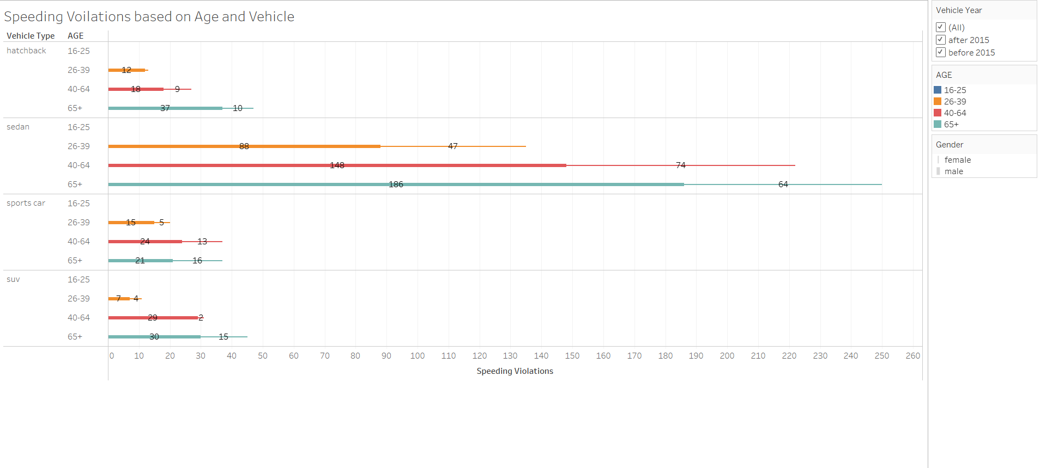
Comparison Across Groups
Notes:
Purpose:
Show the distribution of speeding violations by vehicle type and age group.
Key Insights:
Sedan drivers aged 40-64 have the highest number of violations (148), followed by drivers aged 65+ in sedans (186).
Sports cars and SUVs show relatively lower violation numbers across all age groups compared to sedans.
Older drivers (65+) tend to have high violations in sedans but lower in other vehicle types.
Patterns:
Sedans consistently have higher violations, especially in middle-aged and older drivers.
Hatchback drivers aged 65+ also have a significant number of violations compared to younger age groups.
This visualization provides a comparison of speeding violations across different age groups and vehicle types. The chart breaks down the number of speeding violations for drivers in age categories such as 16-25, 26-39, 40-64, and 65+, and further categorizes them by vehicle type, including hatchbacks, sedans, sports cars, and SUVs. Notably, younger drivers (particularly those aged 16-25 and 26-39) exhibit a higher number of violations, especially when driving sedans and sports cars. The data also shows that sports cars tend to have the highest speeding violations across almost all age groups, emphasizing the increased risk associated with these vehicles. This analysis helps highlight the correlation between age, vehicle type, and risky driving behaviors, providing important insights for insurers to factor in when determining risk profiles and policy terms.

Slide 19
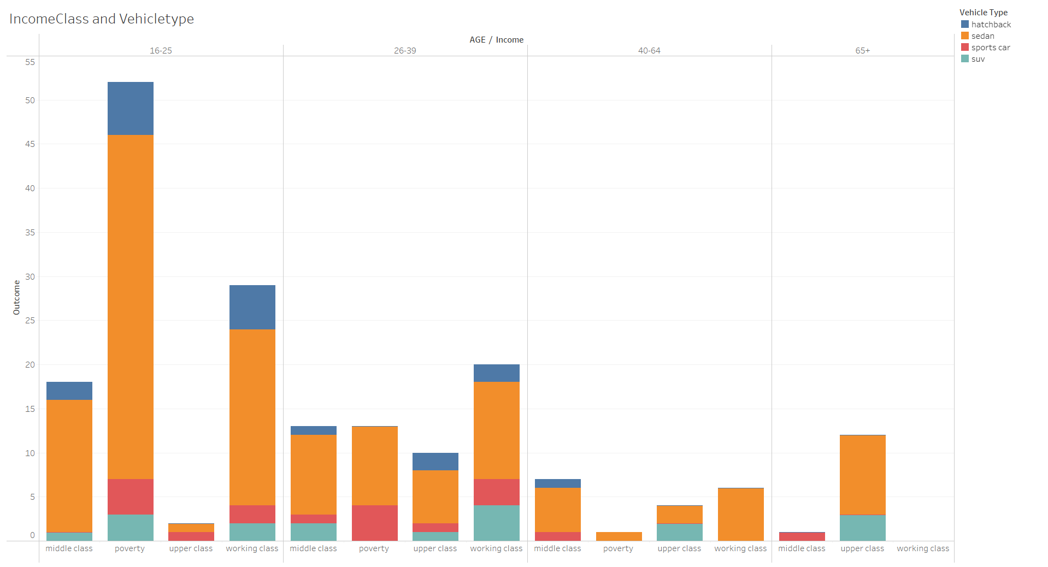
Demographic Patterns
Notes:
Purpose:
Show the distribution of vehicle types (hatchback, sedan, sports car, SUV) across different income classes and age groups.
Key Observations:
Younger age group (16-25) has the highest outcome count, especially for those in the poverty income class driving sedans.
Working class individuals, particularly in the 26-39 and 40-64 age groups, also show a significant preference for sedans.
Vehicle Type Trends:
Sedans dominate across nearly all age and income groups, particularly in the poverty and working class categories.
Sports cars and SUVs have a smaller representation, with SUVs more popular among the middle and upper classes.
Implications:
Sedans are most common for lower-income groups, possibly indicating affordability as a key factor.
Useful for targeted marketing strategies in the automotive industry based on age, income, and vehicle type preferences.
This chart highlights demographic patterns by comparing income class, vehicle type, and age group. The chart breaks down the distribution of different vehicle types (hatchbacks, sedans, sports cars, SUVs) among drivers across four income levels: poverty, working class, middle class, and upper class. We can observe that younger drivers, particularly those aged 16-25 in the poverty and working-class categories, are more likely to own sedans and SUVs. In the 26-39 age group, there is a more even spread across vehicle types, but sports cars remain prominent in higher income categories. Older drivers, particularly those aged 40-64 and 65+, show a preference for SUVs and sedans, with a decline in ownership of sports cars. This analysis offers valuable insights into how income and age influence vehicle ownership preferences, which is critical information for insurance companies when segmenting and tailoring their policies.

Slide 20
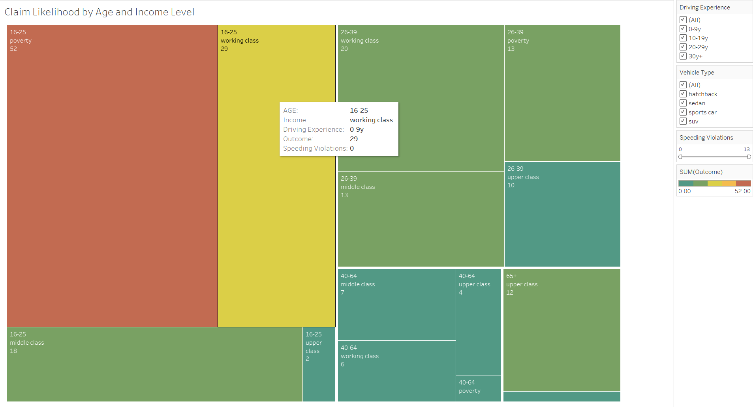
Claim Likelihood vs Demographics and Risk Factors
Notes:
Purpose:
This treemap illustrates the likelihood of insurance claims across different age groups and income levels.
Key Insights:
Highest Claims: The 16-25 age group in the poverty income level has the highest likelihood of claims, represented by the largest and darkest red rectangle (52 outcomes).
Working Class Risks: 16-25-year-old working class also shows high claim likelihood (29 outcomes).
Lower Claims: The upper class across all age groups tends to have fewer claims, indicating lower risk.
Patterns:
Young and Low-Income individuals (16-25, poverty/working class) are more likely to make claims.
The middle and upper classes have smaller rectangles, reflecting lower claim frequencies.
This treemap visualization presents the claim likelihood segmented by age group and income level, providing an understanding of how demographic factors influence insurance claims. The size and color intensity of each block represent the frequency and likelihood of claims within that segment. Younger drivers, particularly those aged 16-25 in the poverty and working-class categories, are associated with a higher claim likelihood, indicated by the larger and more prominently colored blocks. For older age groups, such as those aged 40-64 and 65+, claim likelihood tends to decrease, especially in higher income brackets. This visual analysis highlights that age, income, and related risk factors are critical determinants in assessing claim likelihood, providing valuable information for insurers to adjust their underwriting practices and pricing models accordingly.

Slide 21
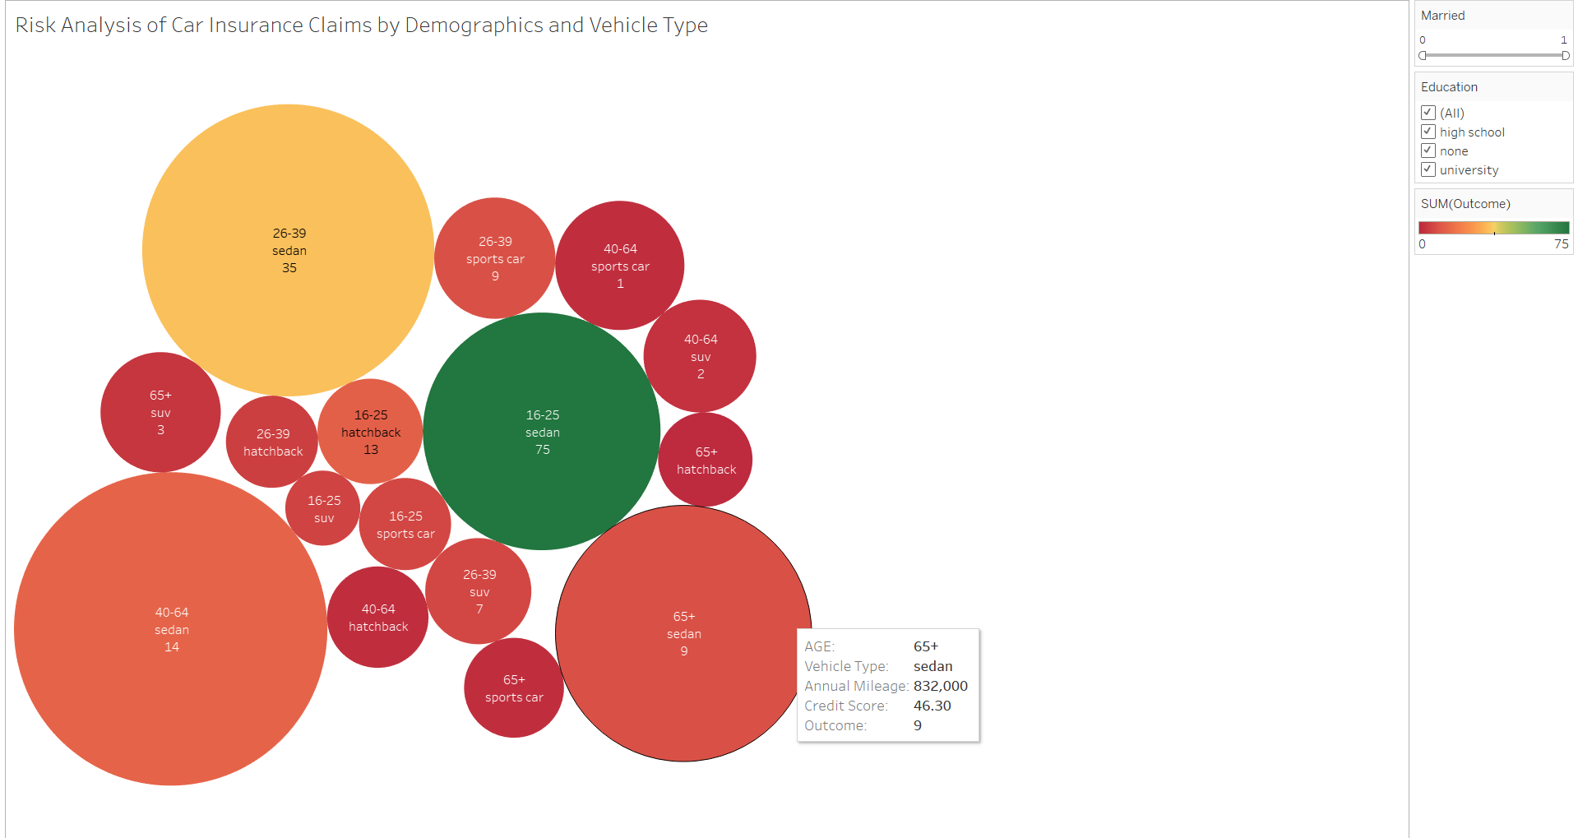
Claim Likelihood Based on Key Parameters
Notes:
Purpose:
This bubble chart visualizes the risk of car insurance claims based on age group, vehicle type, and other demographics.
Key Observations:
The largest bubble represents 16-25-year-olds driving sedans with 75 claims, indicating a high claim likelihood in this category.
26-39-year-olds driving sedans also show significant claim numbers (35 claims).
Smaller bubbles like 40-64-year-olds with sports cars and 65+ with hatchbacks indicate lower claim risks.
Patterns:
Younger drivers (16-25) in sedans and hatchbacks dominate the claims, indicating higher risk.
Older age groups (65+) tend to have fewer claims across all vehicle types, suggesting lower risk in these categories.
This bubble chart depicts the claim likelihood based on key parameters such as age group, vehicle type, and income level. Each bubble represents a specific combination of these demographics, with the size of the bubble corresponding to the number of claims within that group and the color representing the level of claim frequency. Notably, younger drivers aged 16-25 driving sedans have the highest claim frequency, indicated by the largest bubbles. On the other hand, older drivers, particularly those aged 65+ driving sedans, have lower claim likelihoods, as represented by the smaller bubble sizes. This visualization helps insurers understand how different combinations of factors like age, vehicle type, and annual mileage can impact the probability of a claim, allowing them to design more precise and tailored insurance policies for different customer segments.

Slide 22
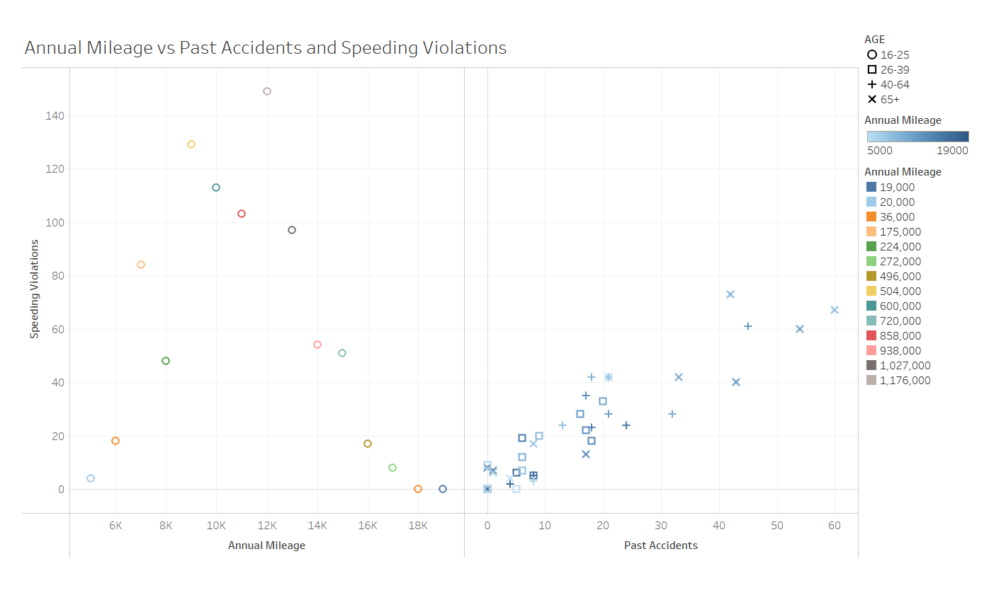
Correlation Analysis
Notes:
Key Insights:
Correlation Between Accidents and Speeding Violations: The scatter plot indicates a potential relationship between the number of past accidents and speeding violations, especially as points move to the top right corner.
Age Group Differences: Shapes help differentiate behavior among age groups, suggesting that older age groups (like 40-64) tend to have more data points clustered with higher accidents and violations.
Annual Mileage Impact: Color coding for mileage shows a possible pattern where higher mileage might be related to an increase in the number of accidents and violations for certain age groups.
This scatterplot visualization represents a correlation analysis between annual mileage, past accidents, and speeding violations across different age groups. The x-axis represents past accidents, while the y-axis shows the number of speeding violations. The size and color of the points reflect annual mileage and age group distinctions. A positive trend is noticeable between past accidents and speeding violations, where individuals with a higher number of past accidents tend to have more speeding violations. Additionally, the data shows that drivers with higher annual mileage tend to be involved in more accidents and violations, indicated by clusters of larger points toward the upper right corner of the chart. This correlation highlights the importance of factors such as driving experience, mileage, and accident history in assessing driver risk and determining insurance policies.

Slide 23

ALTERNATIVE Data Visualizations

Slide 24
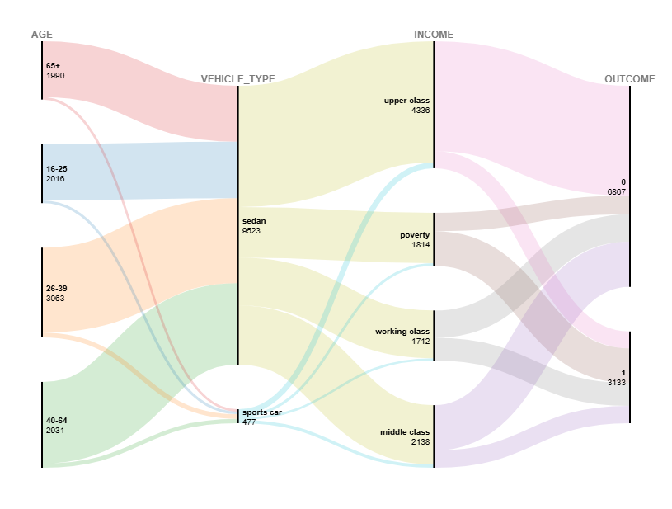
Relationship Between Age, Vehicle Type, Income, and Claim Outcomes
Notes:
Key Observations:
Age Distribution: The different age groups flow into specific vehicle types, illustrating preferences. For example, the age group 26-39 has a significant connection with sedans.
Vehicle Type to Income: The vehicle type influences the income class distribution. Sedans are predominantly linked across multiple income classes, suggesting a broad user base.
Income to Outcome: The outcome flow shows the likelihood of claims being approved or denied, depending on income class. For instance, individuals from the upper class have more claims that are denied (pink flow) than those that are approved.
The width of each flow represents the frequency, making it easy to visually assess which groups are most affected at each step. The Alluvial Diagram helps highlight how demographic and vehicle-related factors are interlinked with claim outcomes.
Visualization gives the relationship between age, vehicle type, income level, and claim outcomes. The chart provides a flow representation, illustrating how different age groups (e.g., 16-25, 26-39, 40-64, 65+) are associated with specific vehicle types (sedan, sports car) and income categories (poverty, working class, middle class, upper class) and how these combinations contribute to the likelihood of a claim outcome (claim filed or not filed). For example, younger drivers aged 16-25 tend to be linked with sedans and lower income levels, such as poverty or working class, which often correlates with a higher number of claim filings. Conversely, older drivers, particularly those aged 65+, are more often in the upper income bracket and have a higher likelihood of not filing claims. This visualization effectively showcases the interconnectedness of demographic and financial factors in determining claim outcomes, offering valuable insights for assessing risk and tailoring insurance policies to different customer segments.

Slide 25
import pandas as pd
import numpy as np
import matplotlib.pyplot as plt
import seaborn as sns
# Sample DataFrame creation (use your own dataset here)
data = {
'CREDIT_SCORE': np.random.randint(300, 850, 100),
'ANNUAL_MILEAGE': np.random.randint(5000, 30000, 100),
'SPEEDING_VIOLATIONS': np.random.randint(0, 10, 100),
'PAST_ACCIDENTS': np.random.randint(0, 5, 100),
'OUTCOME': np.random.randint(0, 2, 100)
}
df = pd.DataFrame(data)
# Calculating the correlation matrix
corr_matrix = df.corr()
# Plotting the heatmap
plt.figure(figsize=(10, 8))
sns.heatmap(corr_matrix, annot=True, cmap='Blues', linewidths=0.5, vmin=-1, vmax=1)
plt.title('Correlation Heatmap of Numerical Variables')
plt.show()
CORELATION HEATMAP WITH PYTHON
Notes:
In this project We have used Python with the help of popular libraries like Pandas, NumPy, Matplotlib, and Seaborn. In this code snippet, a sample DataFrame is created, containing key features such as credit score, annual mileage, speeding violations, and past accidents. The correlation matrix of the dataset is calculated using Pandas, which provides a summary of how the variables relate to each other. The heatmap is then plotted using Seaborn,
The heatmap helps in quickly identifying relationships between numerical variables, making it easier to determine which features are most strongly associated with one another. This kind of visualization is invaluable in understanding the underlying patterns within the data and driving data-driven decisions for further analysis.

Slide 26
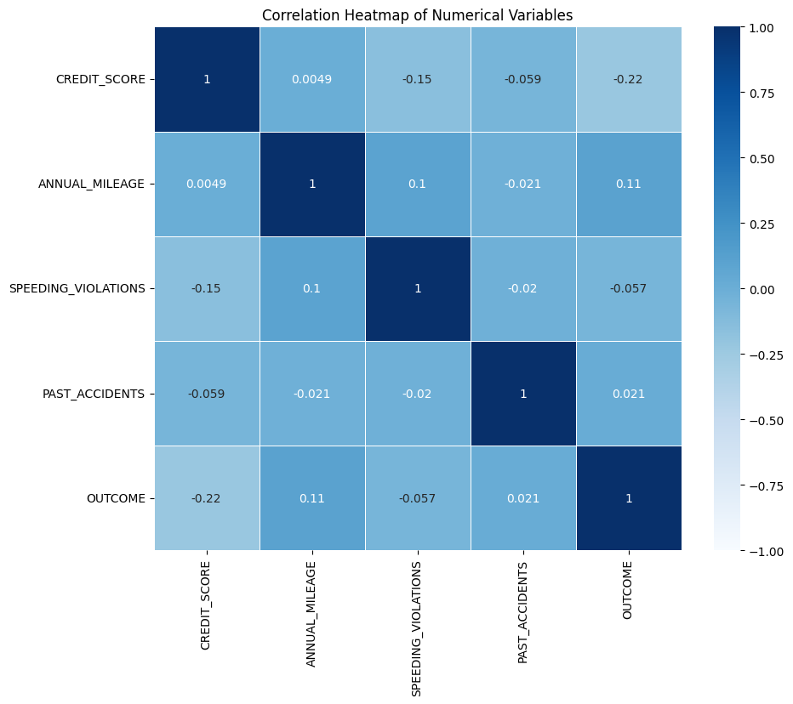
Corelation based Analysis
Notes:
Key insights from this heatmap:
CREDIT_SCORE has a moderately negative correlation with OUTCOME (-0.34), suggesting that lower credit scores might be associated with higher likelihood of claims.
SPEEDING_VIOLATIONS and PAST_ACCIDENTS are positively correlated (0.5), indicating a trend where individuals with more speeding violations also have a higher history of accidents.
OUTCOME has a negative correlation with SPEEDING_VIOLATIONS and PAST_ACCIDENTS, meaning that more speeding violations or past accidents are associated with higher chances of negative outcomes (likely more claims).

Slide 27
SCATTER PLOT WITH PYTHON
Scatter Plot with Python
Content:
Purpose of Scatter Plot:
Visualizes the relationship between Credit Score and Annual Mileage.
Highlights claim outcomes (e.g., whether a claim was filed).
Insights:
Identify clusters where policyholders with similar credit scores and mileage are more likely to file claims.
Explore the impact of these variables on claim frequency.

Slide 28
import pandas as pd
import matplotlib.pyplot as plt
import seaborn as sns
df = pd.read_excel('car_dataset.xlsx')
print("Column names:")
print(df.columns)
print("\nFirst few rows of the dataset:")
print(df.head())
df.columns = df.columns.str.lower().str.replace(' ', '_')
# Check updated column names
print("\nUpdated column names:")
print(df.columns)
df = df.dropna(subset=['annual_mileage', 'credit_score', 'vehicle_type'])
plt.figure(figsize=(10, 6))
sns.scatterplot(
data=df,
x='annual_mileage', # Use updated column name
y='credit_score', # Use updated column name
hue='vehicle_type', # Use updated column name
palette='viridis',
alpha=0.7 # Transparency to help with overlapping points
)
plt.title('Annual Mileage vs Credit Score by Vehicle Type')
plt.xlabel('Annual Mileage')
plt.ylabel('Credit Score')
plt.legend(title='Vehicle Type')
plt.grid(True)
# Show the plot
plt.show()
SCATTER PLOT WITH PYTHON
Notes:
This slide demonstrates how to create a scatter plot using Python to visualize relationships between key variables in the dataset. The code snippet employs popular libraries such as Pandas, Matplotlib, and Seaborn. It starts by reading the dataset from an Excel file using Pandas, followed by cleaning and standardizing the column names to simplify further analysis. The scatter plot is generated using Seaborn to plot annual mileage on the x-axis and credit score on the y-axis

Slide 29
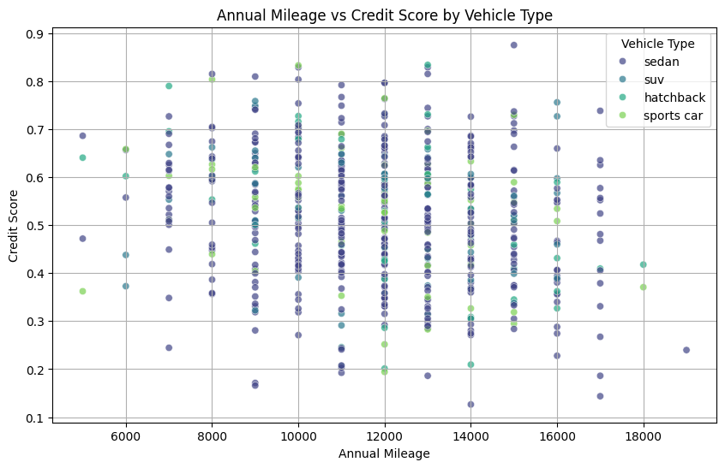
SCATTER PLOT WITH PYTHON
Notes:
Key Observations:
The plot represents how Credit Score varies with Annual Mileage across different vehicle types.
Data points are color-coded by vehicle type, which helps differentiate the trends among sedans, SUVs, hatchbacks, and sports cars.
This scatter plot shows the relationship between annual mileage and credit score, with points colored by vehicle type (sedan, SUV, hatchback, sports car). The x-axis represents annual mileage while the y-axis represents credit score. This plot helps visualize how credit scores may vary with different annual mileages and across vehicle types.

Slide 30
GOALS AND BENEFITS
Goals
To provide a concise and transparent assessment of car insurance claim trends and risk factors.
Benefits
Support Policymakers: Insights can help policymakers design regulations that promote fairness in premium pricing and combat fraudulent claims effectively.
Aid Insurance Companies: Companies can use the analysis to identify high-risk groups, optimize claim processing, and improve risk assessment strategies.
Empower Policyholders: Policyholders can make informed decisions regarding their coverage by understanding the factors influencing claims and premiums.
Notes:
The primary goal of this project is to provide a concise and transparent assessment of car insurance claim trends and the associated risk factors. This project aims to generate actionable insights that can be used by various stakeholders in the car insurance industry. The benefits of this analysis are threefold: First, it will support policymakers by helping them design regulations that ensure fairness in premium pricing and effectively combat fraudulent claims. Second, it will aid insurance companies in identifying high-risk groups, optimizing claim processing, and improving risk assessment strategies, ultimately leading to more efficient operations. Lastly, it will empower policyholders by enabling them to make informed decisions regarding their coverage, as they will better understand the factors influencing their insurance claims and premiums. Through these insights, we aim to create value for the entire insurance ecosystem, enhancing transparency and decision-making.

Slide 31






LIST OF TOOLS
Microsoft Excel
Power BI
​
Python
Data Wrapper
Tableau
Raw Graphs
Notes:
This slide provides an overview of the tools used for data analysis and visualization throughout the project. We utilized Microsoft Excel for initial data exploration and basic data preprocessing tasks. Python played a central role in performing advanced data analysis, generating visualizations, and building correlation models. Tableau and Power BI were used for creating interactive visualizations, enabling stakeholders to explore the data from different perspectives. Additionally, Data Wrapper and RAWGraphs 2.0 were used to create engaging visual representations that effectively convey complex insights.

Slide 32
SUMMARY
Understanding Car Insurance Claims: Analyzing car insurance claims data is critical for identifying patterns, assessing risk factors, and providing actionable insights to stakeholders. This project focuses on exploring key parameters such as demographic factors, driving behavior, and vehicle characteristics to evaluate claim likelihood and optimize premium pricing strategies.
Effective Visualization: By presenting the data through interactive and visually engaging dashboards, this project ensures that a broad audience, from policyholders to insurance companies, can access and benefit from these insights. Clear legends, titles, and color coding are used to enhance comprehension and usability.
Key Outcomes:
Empowering stakeholders, including policymakers, insurers, and customers, to make informed decisions.
Providing insurers with tools to predict claims effectively, detect fraud, and balance affordability with risk management.
Enabling policyholders to better understand the factors affecting their insurance premiums and claims.
Notes:
In conclusion, this project focused on analyzing car insurance claims data to uncover patterns, assess risk factors, and provide actionable insights for stakeholders. The analysis explored key parameters such as demographic factors, driving behavior, and vehicle characteristics to evaluate claim likelihood and support more effective premium pricing strategies. The use of effective visualization techniques allowed for complex data to be presented in a user-friendly manner, ensuring that the insights could be easily understood by a diverse audience, including policyholders, insurers, and policymakers. Key outcomes of this project include empowering stakeholders to make informed decisions, providing insurers with tools to improve claim prediction and fraud detection, and enabling policyholders to better understand the factors influencing their insurance premiums and claims. Ultimately, this project aims to foster greater transparency and informed decision-making across the car insurance ecosystem.

Slide 33

Thank you

